Slide 1
Lecture 14
Tidy Data with tidyr
Pivoting
Relational Data

Slide 2
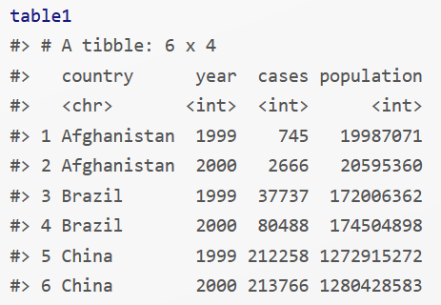
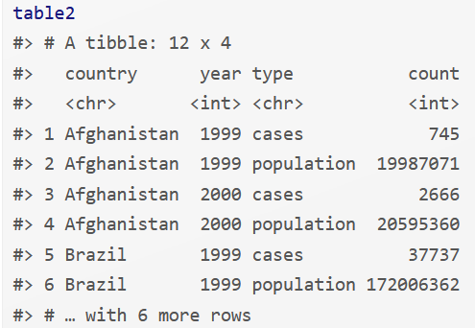
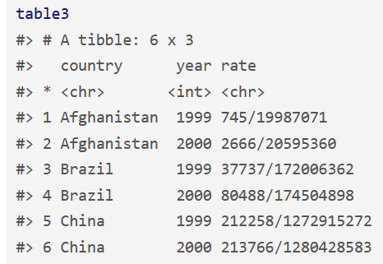
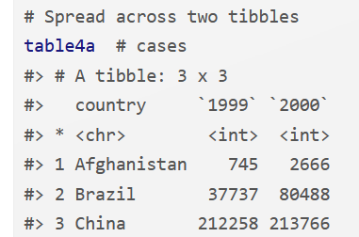
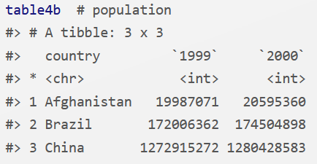
Tidy Data
Any dataset can be represented in multiple ways
  Consider four dataset, each with four variables: country, year, population, and cases
  Four representations of same dataset are not all easy to use

Slide 3
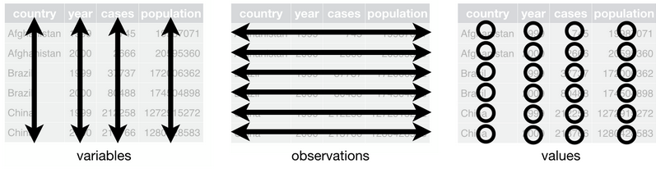
Tidy Data
Rules to make dataset tidy
  Each variable must have its own column
  Each observation must have its own row
  Each value must have its own cell
  The rules are inter-related and it is not possible to satisfy only two of the three
  More practical set of rules:
  1. Put each dataset in a tibble
  2. Put each variable in a column

Slide 4
Tidy Data: Advantages
There are two main advantages to ensure data is tidy:
  Consistency of data structures makes it easier to learn data analysis tools
    Formatting data in one consistent way makes this easier
    Uniformity of underlying structures very helpful
  Placing variables in columns makes vectorization easy in R
    Useful functions math operations for creating new variables are easily applied, e.g.,
      Arithmetic operations:+, -, *, /, ^ Logarithms: log(), log2(), log10()
      Modular arithmetic: %/%, %% Logical Comparisons: <, <=, >, >=, != Ranking: desc(x)
    Useful built-in summary functions can be easily applied
  Measures of location: mean(x), median(x)
  Measures of spread: sd(x), IQR(), mad(x), min(x), max(), quantile(x, 0.25)
  Measures of position: x[1], x[2], x[length(x)]
  Counts: n(), sum(!is.na(x)), n_distinct(x)

Slide 5
Tidy Data: Advantages
There are two main advantages to ensure data is tidy:
  Consistency of data structures makes it easier to learn data analysis tools
    Formatting data in one consistent way makes this easier
    Uniformity of underlying structures very helpful
  Placing variables in columns makes vectorization easy in R
    Useful functions math operations for creating new variables are easily applied, e.g.,
      Arithmetic operations:+, -, *, /, ^ Logarithms: log(), log2(), log10()
      Modular arithmetic: %/%, %% Logical Comparisons: <, <=, >, >=, != Ranking: desc(x)
    Useful built-in summary functions can be easily applied
  Measures of location: mean(x), median(x)
  Measures of spread: sd(x), IQR(), mad(x), min(x), max(), quantile(x, 0.25)
  Measures of position: x[1], x[2], x[length(x)]
  Counts: n(), sum(!is.na(x)), n_distinct(x)
tidyverse packages (e.g.,dplyr, ggplot2) work with tidy data

Slide 6
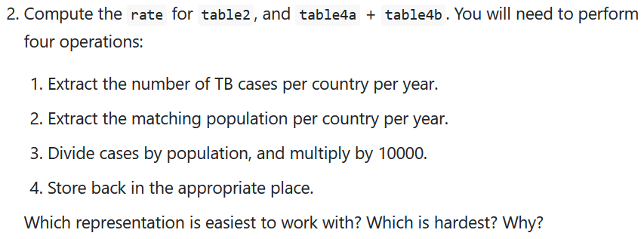
Exercise 12.2.2
  Table 2: Each row represents a (country, year, variable) combination.
  The column count contains the values of variables cases and population in separate rows
  Table 4: The table is split into two tables, one table for each variable.
    Table 4a contains values of cases and
    Table 4b contains values of population.
    For each table, each row represents a country, each column represents a year,
    and the cells are the value of the table’s variable for that country and year.

Slide 7
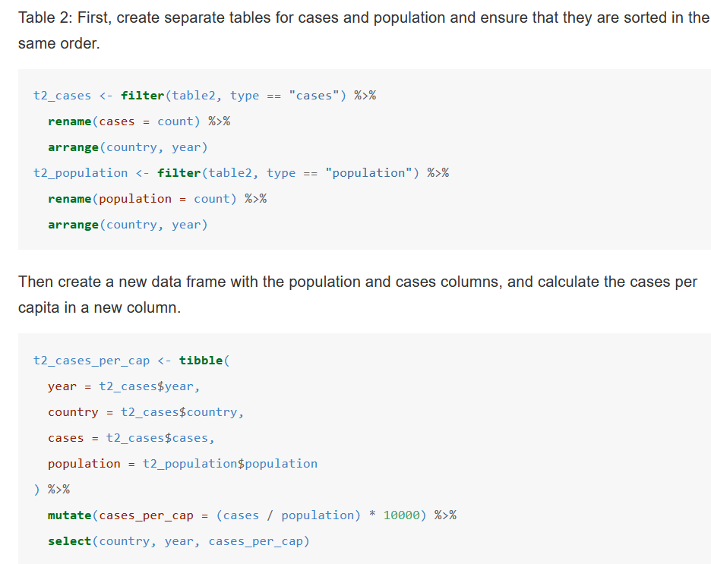
Exercise 12.2.2: Solution

Slide 8
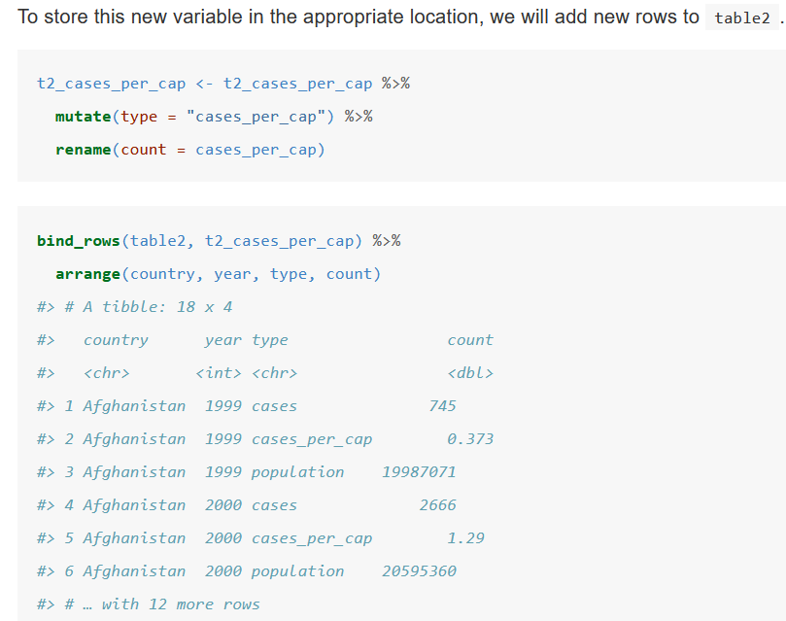

Slide 9
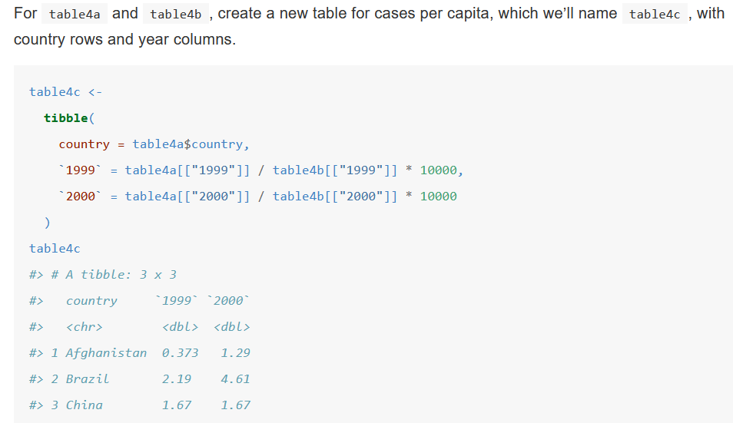
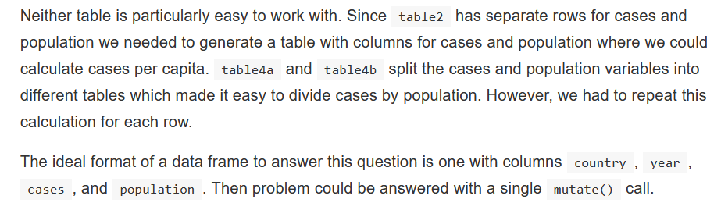

Slide 10
Pivoting
Most data we encounter will be untidy because
  most people are not familiar with tidy data
  data often organized for some other purpose than analysis
Two common problems
  One variable may spread across multiple columns
  One observation may be scattered across multiple rows
Fixing these problems require tidyr pivot functions from tidyverse:
library(tidyverse)
  gather() and spread() replaced with
  pivot_longer() and pivot_wider()

Slide 11
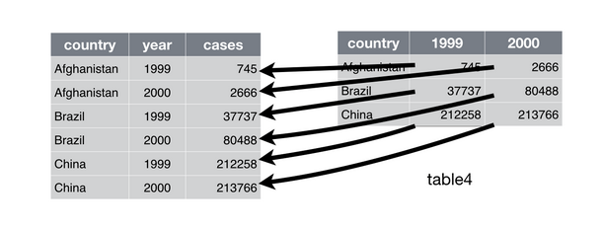
Pivoting: Longer
pivot_longer() makes datasets longer by increasing the number of row and decreasing the number of columns
Consider Table 4a:
Columns 1999 and 2000 are values, not variables
Name of variable to move column name to (year)
Name of variable to move column value to (cases)
table4a %>%
pivot_longer(c(`1999`, `2000`), names_to = "year", values_to = "cases")
#> # A tibble: 6 x 3
#> country year cases
#> <chr> <chr> <int>
#> 1 Afghanistan 1999 745
#> 2 Afghanistan 2000 2666
#> 3 Brazil 1999 37737
#> 4 Brazil 2000 80488
#> 5 China 1999 212258
#> 6 China 2000 213766

Slide 12
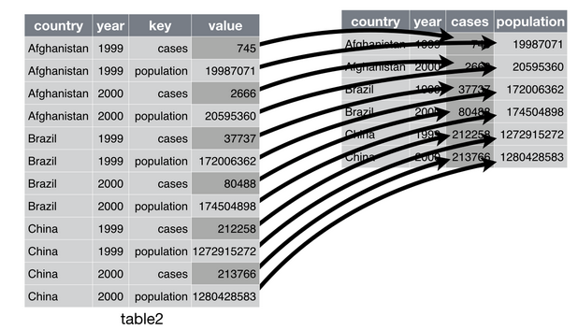
Pivoting: Wider
pivot_wider() makes datasets wider by increasing the number of columns and decreasing the number of rows
Consider Table 2: - Columns 1999 and 2000 are values, not variables
- Column to take variable from (type)
- Column to take values from to (count)
table2 %>%
pivot_wider(names_from = type, values_from = count)
#> # A tibble: 6 x 4
#> country year cases population
#> <chr> <int> <int> <int>
#> 1 Afghanistan 1999 745 19987071
#> 2 Afghanistan 2000 2666 20595360
#> 3 Brazil 1999 37737 172006362
#> 4 Brazil 2000 80488 174504898
#> 5 China 1999 212258 1272915272
#> 6 China 2000 213766 1280428583

Slide 13
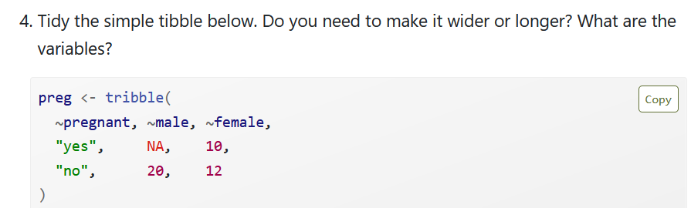
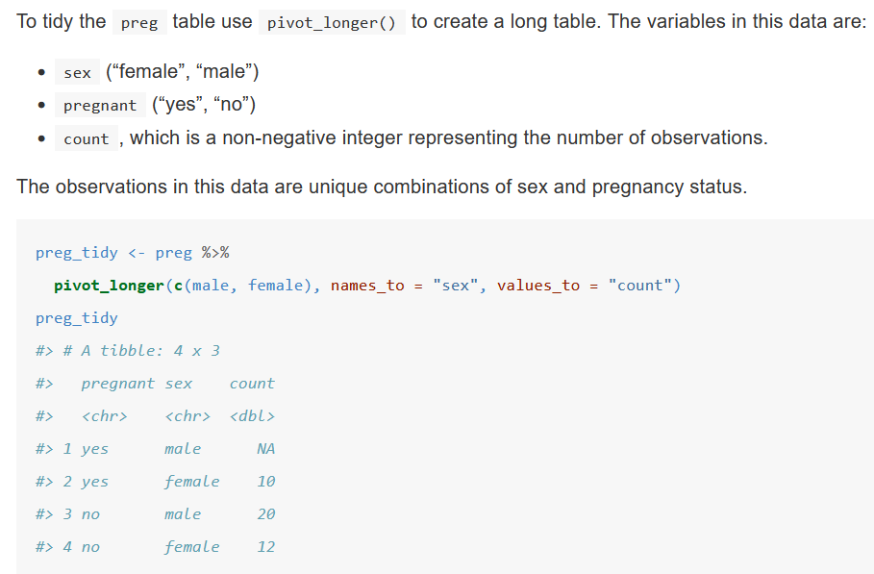
Exercise 12.3.4
Solution:

Slide 14
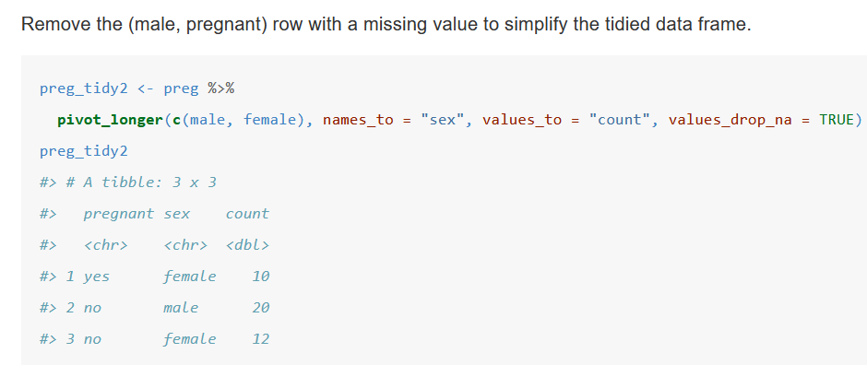

Slide 15
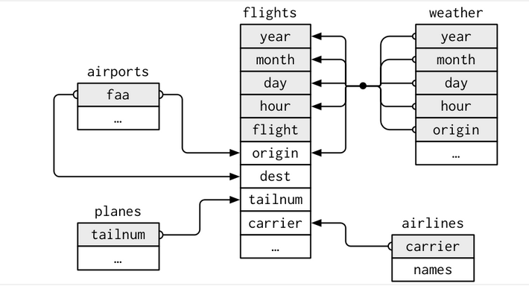
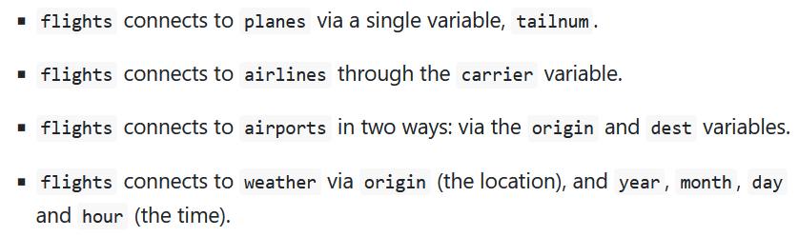
Relational Data
Relational data analysis explore relationships between multiple datasets
Relational data analysis requires three families of verbs
  Mutating joins – add new variables to one data frame from matching observations from another
  Filtering joins – filter observations from one data frame based on whether or not they match
  observations in the other table
  Set operations – treat observation as if they were sets
Consider four tibbles with nycflights13
  airlines – look up full airport name from code
  airports – gives airport information based on FAA code
  planes – gives information about planes based on talinum
  weather – gives weather at each NYC airport for each hour
  Observed Relationships

Slide 16
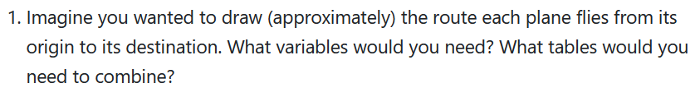
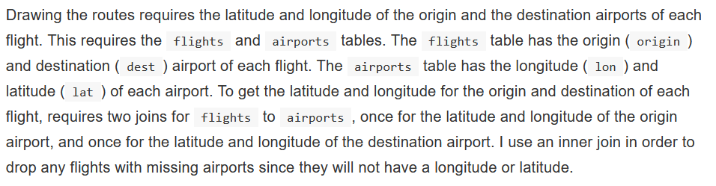
Exercise 13.2.1
  Solution
library("tidyverse")
library("nycflights13")

Slide 17
flights_latlon <- flights %>%
inner_join(select(airports, origin = faa, origin_lat = lat, origin_lon = lon),
by = "origin"
) %>%
inner_join(select(airports, dest = faa, dest_lat = lat, dest_lon = lon),
by = "dest"
)
Plot the approximate flight paths of the first 100 flights in the flights dataset:
flights_latlon %>%
slice(1:100) %>%
ggplot(aes(
x = origin_lon, xend = dest_lon,
y = origin_lat, yend = dest_lat
)) +
borders("state") +
geom_segment(arrow = arrow(length = unit(0.1, "cm"))) +
coord_quickmap() +
labs(y = "Latitude", x = "Longitude")

Slide 18
